Slide 1
CSCI 475/585 Information Security and Privacy Fall 2019
Chapter 3 – User Authentication
Week 3
Notes:
Lecture slides prepared by Dr Lawrie Brown (UNSW@ADFA) for “Computer Security: Principles and Practice”, by William Stallings and Lawrie Brown, Chapter 3 “User Authentication”.
Enhanced and Modified by Chuan Yue at the Colorado School of Mines.

Slide 2
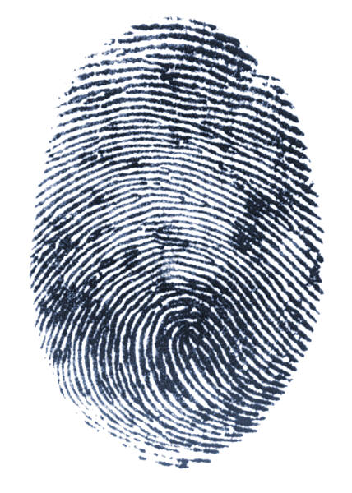

RFC 4949
RFC 4949 (Internet Security Glossary) defines user authentication as:
“The process of verifying an identity claimed by or for a system entity.”
Notes:
RFC 4949 defines user authentication as follows:
The process of verifying an identity claimed by or for a system entity.

Slide 3
Authentication Process
Fundamental building block and primary line of defense
Basis for access control and user accountability
Identification step
Presenting an identifier to the security system
Verification step
Presenting or generating authentication information that corroborates the binding between the entity and the identifier
Notes:
An authentication process consists of two steps:
Identification step: Presenting an identifier to the security system. (Identifiers
should be assigned carefully, because authenticated identities are the basis for
other security services, such as access control service.)
Verification step: Presenting or generating authentication information that
corroborates the binding between the entity and the identifier.
For example, user Alice Toklas could have the user identifier ABTOKLAS. This
information needs to be stored on any server or computer system that Alice wishes
to use and could be known to system administrators and other users. A typical item
of authentication information associated with this user ID is a password, which is
kept secret (known only to Alice and to the system). If no one is able to obtain or
guess Alice’s password, then the combination of Alice’s user ID and password enables
administrators to set up Alice’s access permissions and audit her activity. Because
Alice’s ID is not secret, system users can send her e-mail, but because her password is
secret, no one can pretend to be Alice.
In essence, identification is the means by which a user provides a claimed identity
to the system; user authentication is the means of establishing the validity of the claim.
Note that user authentication is distinct from message authentication. As defined in
Chapter 2, message authentication is a procedure that allows communicating parties
to verify that the contents of a received message have not been altered and that the
source is authentic. This chapter is concerned solely with user authentication.

Slide 4
Means of User Authentication
four means of authenticating user's identity
based on
something you have - e.g. key, token, smartcard
something you know - e.g. password, PIN
something you are
static biometrics - e.g. fingerprint, retina, face
dynamic biometrics - e.g. voice, typing
somebody you know - the social network of the user, CCS’06
all can provide user authentication
all have issues
should use Multi-Factor Authentication (MFA)
Notes:
Enhanced and Modified by Chuan Yue at the Colorado School of Mines.
Chuan: Fourth-Factor Authentication: Somebody You Know, CCS2006
There are four general means of authenticating a user's identity, which can be used alone or in combination:
• Something the individual knows: Examples includes a password, a personal identification number (PIN), or answers to a prearranged set of questions.
• Something the individual possesses: Examples include electronic keycards, smart cards, and physical keys. This type of authenticator is referred to as a token.
• Something the individual is (static biometrics): Examples include recognition by fingerprint, retina, and face.
• Something the individual does (dynamic biometrics): Examples include recognition by voice pattern, handwriting characteristics, and typing rhythm.
All of these methods, properly implemented and used, can provide secure user authentication. However, each method has problems. An adversary may be able to guess or steal a password. Similarly, an adversary may be able to forge or steal a token. A user may forget a password or lose a token. Further, there is a significant administrative overhead for managing password and token information on systems and securing such information on systems. With respect to biometric authenticators, there are a variety of problems, including dealing with false positives and false negatives, user acceptance, cost, and convenience.

Slide 5
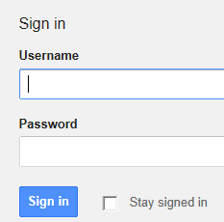
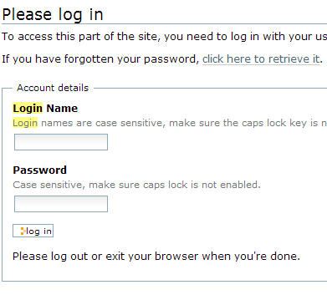
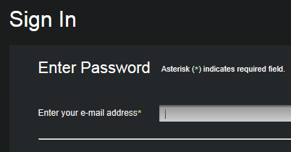
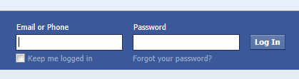
Text Passwords: the Dominant Position in Online User Authentication ^{[1]}
[1] J. Bonneau et al., The quest to replace passwords: A framework for comparative evaluation of web authentication schemes. In Proc. of IEEE S&P Symposium, 2012
Notes:
Added by Chuan Yue at the Colorado School of Mines.

Slide 6
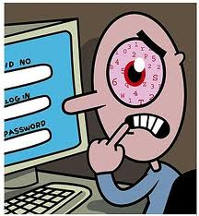
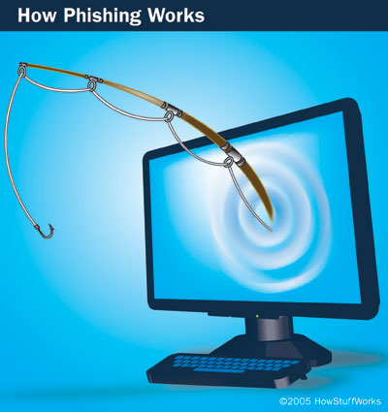
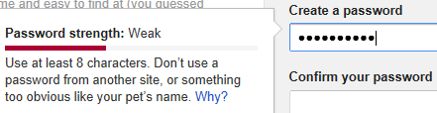
Password Security Problems -critical, long-standing, and challenging
The something you know authentication factor
Requirements: strong, protect them from being stolen
The reality: create weak passwords, share passwords, insecurely store passwords, fall victim to phishing attacks^{[1,2,3]}
[1] D. Florˆencio and C. Herley. A large-scale study of web password habits. In Proc. of WWW, 2007
[2] S. Komanduri et al. Of passwords and people: Measuring the effect of password-composition policies. In Proc. of CHI, 2011.
[3] J. Hong. The state of phishing attacks. Communications of the ACM, 2012
Notes:
Added by Chuan Yue at the Colorado School of Mines.

Slide 7
Password Vulnerabilities
offline dictionary attack
specific account attack
popular password attack
workstation hijacking
exploiting user mistakes
exploiting password reuse
insecure transmission
……
Notes:
Enhanced and Modified by Chuan Yue at the Colorado School of Mines.
We can identify the following attack strategies and countermeasures:
• Offline dictionary attack: A determined hacker may bypass access controls and gain access to the system password file. The attacker then compares the password hashes against hashes of commonly used passwords.
• Specific account attack: The attacker targets a specific account and submits password guesses until the correct password is discovered.
• Popular password attack: The attacker chooses a popular password and try it against a wide range of user IDs.
• Password guessing against single user: The attacker attempts to gain knowledge about the account holder and system password policies and uses that knowledge to guess the password.
• Workstation hijacking; The attacker waits until a logged-in workstation is unattended.
• Exploiting user mistakes: If the system assigns a password, then the user is more likely to write it down because it is difficult to remember.
• Exploiting multiple password use. When different network devices share the same or a similar password for a given user.
• Electronic monitoring: If a password is communicated across a network to log on to a remote system, it is vulnerable to eavesdropping.

Slide 8
Countermeasures
stop unauthorized access to password file
intrusion detection measures
account lockout mechanisms
training & enforcement of policies
automatic workstation logout
encrypted network links
……
Notes:
Countermeasures against the listed vulnerabilities include controls to: prevent unauthorized access to the password file, intrusion detection measures to identify a compromise, rapid re-issuance of passwords should the password file be compromised; account lockout mechanism which locks out access to the account after a number of failed login attempts; policies to inhibit the selection by users of common passwords; training in and enforcement of password policies that make passwords difficult to guess; automatically logging the workstation out after a period of inactivity; a policy that forbids the same or similar password on particular network devices; encrypted communications links.

Slide 9
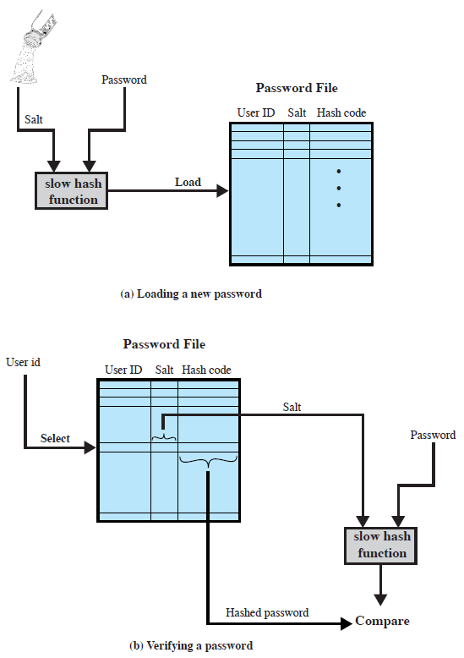
Use of Hashed Passwords at the Server-Side
Linux password files:
/etc/passwd
smithj:x:561:561:Joe Smith:/home/smithj:/bin/bash
/etc/shadow
smithj:$6$QR3drPrQ$JLolPKyiVuXvea1F2IpbPx9F9PEV0s/IGcNCpm6ZrBA6AFDvwHPQG7EsTQHuUqxfCvlsuKRb.O7w5RLPyj8nS/:15119:0:99999:7:::
In 2012, Yahoo Hack Leaks 453,000 Passwords of Yahoo Voices Users; Not even hashed!
In 2012, 6.5 million unsalted SHA1 hashed LinkedIn passwords have appeared in the criminal underground.
Notes:
Enhanced and Modified by Chuan Yue at the Colorado School of Mines.
Chuan:
http://www.tldp.org/LDP/lame/LAME/linux-admin-made-easy/shadow-file-formats.html
https://administratosphere.wordpress.com/2011/05/27/etcshadow-format/
A widely used password security technique is the use of hashed passwords and a salt value. This scheme is found on virtually all UNIX variants as well as on a number of other operating systems. The procedure shown here in Figure 3.1a from the text is used. To load a new password into the system, the user selects or is assigned a password.This password is combined with a fixed-length salt value (so the same user password can create multiple hash values, depending on which salt is used. to make attacks harder). In older implementations, the salt is related to the time the password is assigned to the user. Newer implementations use a pseudorandom or random number. The password and salt serve as inputs to a hashing algorithm to produce a fixed-length hash code. The hash algorithm is designed to be slow to execute to thwart attacks. The hashed password is then stored, together with a plaintext copy of the salt, in the password file for the corresponding user ID. The hashed-password method has been shown to be secure against a variety of cryptanalytic attacks. When a user attempts to log on to a system, the user provides an ID and a password (as shown in Figure 3.1b). The operating system uses the ID to index into the password file and retrieve the plaintext salt and the encrypted password. The salt and user-supplied password are used as input to the encryption routine. If the result matches the stored value, the password is accepted. There are two threats to this password scheme. First, a user can gain access on a machine using a guest account or by some other means and then run a password guessing program, called a password cracker, on that machine. In addition, if an opponent is able to obtain a copy of the password file, then a cracker program can be run on another machine at leisure. This enables the opponent to run through millions of possible passwords in a reasonable period.

Slide 10
Password Cracking Approaches
dictionary attacks
try each possible password then obvious variants in large dictionary against hash in password file
rainbow table attacks
precompute tables of hash values of all possible passwords
a mammoth table of hash values
e.g. 1.4GB table cracks 99.9% of alphanumeric Windows passwords in 13.8 secs
not feasible if larger salt values used
Notes:
The traditional approach to password guessing, or password cracking as it is called, is to develop a large dictionary of possible passwords and to try each of these against the password file. This means that each password must be hashed using each available salt value and then compared to stored hash values. If no match is found, then the cracking program tries variations on all the words in its dictionary of likely passwords. Such variations include backward spelling of words, additional numbers or special characters, or sequence of characters, An alternative is to trade off space for time by precomputing potential hash values. In this approach the attacker generates a large dictionary of possible passwords. For each password, the attacker generates the hash values associated with each possible salt value. The result is a mammoth table of hash values known as a rainbow table. For example, [OECH03] showed that using 1.4 GB of data, he could crack 99.9% of all alphanumeric Windows password hashes in 13.8 seconds. This approach can be countered by using a sufficiently large salt value and a sufficiently large hash length. Both the FreeBSD and OpenBSD approaches should be secure from this attack for the foreseeable future.

Slide 11
Password File Access Control
can block offline guessing attacks by denying access to hashed passwords
make available only to privileged users
often using a separate (from user IDs) shadow password file as we saw in the example
still have vulnerabilities
exploit OS bugs
error on permissions making it readable
users reuse same password on other systems
access from unprotected backup media
sniff passwords in unprotected network traffic
Notes:
One way to thwart a password attack is to deny the opponent access to the password file. If the hashed password portion of the file is accessible only by a privileged user, then the opponent cannot read it without already knowing the password of a privileged user. Often, the hashed passwords are kept in a separate file from the user IDs, referred to as a shadow password file. Special attention is paid to making the shadow password file protected from unauthorized access. Although password file protection is certainly worthwhile, there remain vulnerabilities: a hacker may be able to exploit a software vulnerability in the operating system to bypass the access control system long enough to extract the password file; an accident of protection might render the password file readable; some users may use the same password on other less protected or compromised machines; a lack of or weakness in physical security (e.g. of backups) may provide opportunities for a hacker to access a copy of the file; passwords may be captured by sniffing network traffic.

Slide 12
Using Better Passwords
clearly have problems with passwords
goal to eliminate guessable passwords
whilst still easy for user to remember
techniques:
user education
reactive password checking
proactive password checking
Notes:
Enhanced and Modified by Chuan Yue at the Colorado School of Mines.
The lesson from the two experiments just described (Tables 3.1and 3.2) is that, when not constrained,many users choose a password that is too short or too easy to guess. At the other extreme,if users are assigned passwords consisting of eight randomly selected printable characters, password cracking is effectively impossible. But it would be almost as impossible for most users to remember their passwords. Fortunately, even if we limit the password universe to strings of characters that are reasonably memorable, the size of the universe is still too large to permit practical cracking. Our goal, then, is to eliminate guessable passwords while allowing the user to select a password that is memorable. Four basic techniques are in use:
• User education - Users can be told the importance of using hard-to-guess passwords and can be provided with guidelines for selecting strong passwords. Can be problematic when have a large user population or a lot of turnover, and because many users will simply ignore the guidelines.
• Computer-generated passwords - have a history of poor acceptance by users, if random in nature, users will not remember them, if pronounceable, the user may still be tempted to write it down.
• Reactive password checking - where the system periodically runs its own password cracker to find guessable passwords.The system cancels any passwords that are guessed and notifies the user. Can be costly in resources to implement.
• Proactive password checking - where user selects own password which the system then checks to see if it is is allowable and, if not, rejects it. It must strike a balance between user acceptability and strength. Likely the best solution.

Slide 13
Reactive Password Checking
System periodically runs its own password cracker to find guessable passwords.
John the Ripper password cracker
Resource intensive, vulnerable until identification

Slide 14
Proactive Password Checking
rule enforcement plus user advice, e.g.
8+ chars, upper/lower/numeric/special character
may not suffice
use password cracker to reject bad passwords
time and space issues
Markov Model
generates guessable passwords
hence reject any password it might generate
Bloom Filter
use to build table based on dictionary using hashes
check desired password against this table
Notes:
Now look at possible approaches to proactive password checking.
The first approach is a simple system for rule enforcement coupled with advice to the user, e.g:
• All passwords must be at least eight characters long.
• In the first eight characters, the passwords must include at least one each of uppercase, lowercase, numeric digits, and punctuation marks.
Another method is to compile a large dictionary of possible “bad”passwords. When a user selects a password, the system runs a Password Cracker to make sure that it is not on the disapproved list. This still consumes significant time and space.
Use a Markov Model for the generation of guessable passwords, and reject any passwords likely to be generated by the model (see text for more details).
Use a Bloom filter, which is a set of k independent hash functions which map a password into a set of hash values in the range 0 … N–1. These are used to set bits in a lookup table of size N. When a new password is presented to the checker, its k hash values are calculated. If all the corresponding bits of the hash table are equal to 1, then the password is rejected. All passwords in the dictionary will be rejected. But there will also be some other “false positives” (see text for more details).

Slide 15
Some Other Popular Solutions
Graphical passwords
Security and usability concerns
Password hashing systems
Security and usability concerns
Single sign-on systems
Business model limitations, security concerns ^{[1]}
Browser-based password managers
Easily save and autofill, users don’t need to remember
Potentially protect against phishing attacks
[1] C. Yue. The Devil is Phishing: Rethinking Web Single Sign-On Systems Security. In Proc. of LEET, 2013
Notes:
Enhanced and Modified by Chuan Yue at the Colorado School of Mines.

Slide 16

PwdHash (Ross, B., Jackson, C., Miyake, N., Boneh, D., Mitchell, J.C.: Stronger password authentication using browser extensions. In: Proc. of the USENIX Security Symposium, 2005)
Bank A
Hash (Pwd_{A,} BankA)
Hash (Pwd_{A,} SpoofedBankA)
Spoofed Bank A
PwdHash
(Browser Extension)
Plain-text password: PwdA
Site-password: Hash (PwdA, BankA)
Unique password per site (domain name is the salt)
Focuses on protecting against phishing attacks
Notes:
Added by Chuan Yue at the Colorado School of Mines.
PwdHash is a browser extension and is a pure browser-based solution.
Using the website domain name as the salt, PwdHash hashes a user’s original plain-text password to generate a site password. The generated site password will be used to log into a website. Even if a user types in the same plain-text password on different websites, the generated passwords that actually sent to those sites are different.
Therefore, PwdHash can help a user protect against phishing attacks because the stolen password received at the phishing site cannot be directly used to log into the corresponding legitimate website.

Slide 17
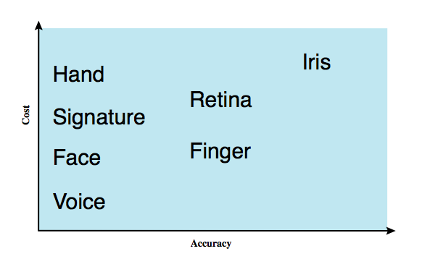
Biometric Authentication
authenticate user based on one of their physical characteristics
Notes:
A biometric authentication system attempts to authenticate an individual based on unique physical characteristics.These include static characteristics, such as fingerprints, hand geometry, facial characteristics, and retinal and iris patterns; and dynamic characteristics, such as voiceprint and signature. Compared to passwords and tokens, biometric authentication is both technically complex and expensive, and have yet to mature as a standard tool for user authentication to computer systems. Figure 3.6 from the text gives a rough indication of the relative cost and accuracy of the most common biometric measures:
• Facial characteristics: define characteristics based on relative location and shape of key facial features, such as eyes, eyebrows, nose, lips, and chin shape.
• Fingerprints: the pattern of ridges and furrows on the surface of the fingertip, believed to be unique across the entire human population. Automated fingerprint systems extract a number of features to use as a surrogate for the full pattern.
• Hand geometry: identify features of hand,: e.g. shape, lengths & widths of fingers.
• Retinal pattern: formed by veins beneath the retinal surface is unique and therefore suitable for identification. Uses a digital image of the retinal pattern by projecting a low-intensity beam of visual or infrared light into the eye.
• Iris: Another unique physical characteristic is the detailed structure of the iris.
• Signature: each individual has a unique style of handwriting, esp in signature.
• Voice: patterns are more closely tied to physical and anatomical characteristics of the speaker, but still have a variation from sample to sample over time from the same speaker,complicating the biometric recognition task.

Slide 18
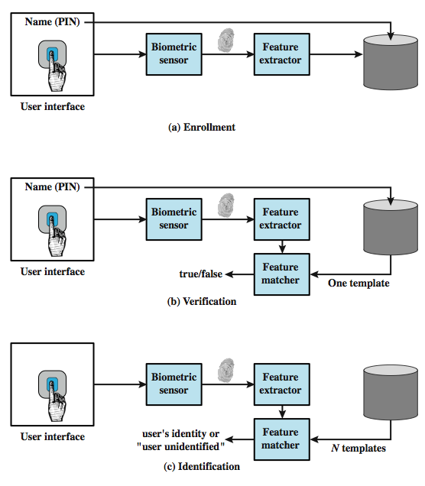
Operation of a Biometric System
Notes:
Figure 3.7 from the text illustrates the operation of a biometric system. Each individual who is to be included in the database of authorized users must first be enrolled in the system. This is analogous to assigning a password to a user .For a biometric system, the user presents a name and, typically, some type of password or PIN to the system. At the same time the system senses some biometric characteristic of this user (e.g. fingerprint of right index finger). The system digitizes the input and then extracts a set of features that can be stored as a number or set of numbers representing this unique biometric characteristic ;this set of numbers is referred to as the user’s template. The user is now enrolled in the system, which maintains for the user a name (ID), perhaps a PIN or password, and the biometric value. Depending on application, user authentication on a biometric system involves either verification or identification. Verification is analogous to a user logging on to a system by using a memory card or smart card coupled with a password or PIN. For biometric verification, the user enters a PIN and also uses a biometric sensor. The system extracts the corresponding feature and compares that to the template stored for this user. If there is a match, then the system authenticates this user. For an identification system, the individual uses the biometric sensor but presents no additional information. The system then compares the presented template with the set of stored templates. If there is a match, then this user is identified. Otherwise, the user is rejected.

Slide 19
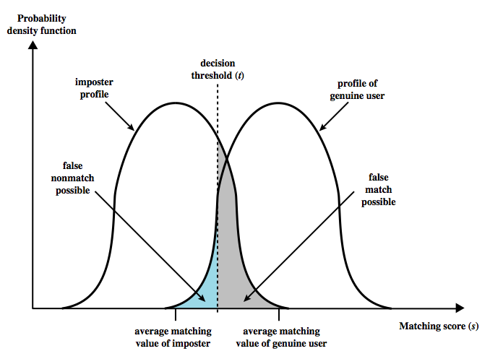
Biometric Accuracy
never get identical templates
problems of false match / false non-match
Notes:
In any biometric scheme, some physical characteristic of the individual is mapped into a digital representation. For each individual, a single digital representation, or template, is stored in the computer. When the user is to be authenticated, the system compares the stored template to the presented template. Given the complexities of physical characteristics, we cannot expect that there will be an exact match between the two templates. Rather, the system uses an algorithm to generate a matching score (typically a single number) that quantifies the similarity between the input and the stored template. Figure 3.8 illustrates the dilemma posed to the system. If a single user is tested by the system numerous times, the matching score swill vary, with a probability density function typically forming a bell curve, as shown. On average, any other individual should have a much lower matching score but again will exhibit a bell-shaped probability density function .The difficulty is that the range of matching scores produced by two individuals, one genuine and one an imposter, compared to a given reference template, are likely to overlap. In Figure 3.8 a threshold value is selected so that if the presented value is s>=t then a match is assumed, and for s< t, a mismatch is assumed. The shaded part to the right of t indicates a range of values for which a false match is possible, and the shaded part to the left indicates a range of values for which a false nonmatch is possible. The area of each shaded part represents to probability of a false match or nonmatch, respectively. By moving the threshold, left or right, the probabilities can be altered, but note that an decrease in false match rate necessarily results in an increase in false nonmatch rate, and vice versa.

Slide 20
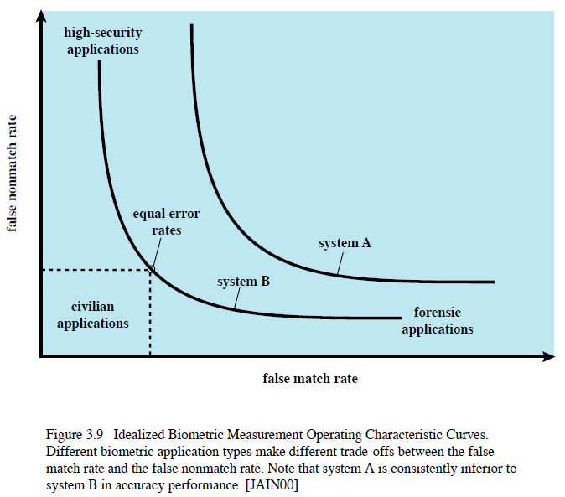
Biometric Accuracy
can plot Operating Characteristic curve
pick threshold balancing error rates
Notes:
For a given biometric scheme, we can plot the false match versus false non-match rate, called the operating characteristic curve. Figure 3.9 in the text shows representative curves for two different systems. A reasonable tradeoff is to pick a threshold t that corresponds to a point on the curve where the rates are equal. A high-security application may require a very low false match rate, resulting in a point farther to the left on the curve. For a forensic application, in which the system is looking for possible candidates, to be checked further, the requirement may be for a low false non-match rate. Figure 3.10 on this slide from the text, shows characteristic curves developed from actual product testing. The iris system had no false matches in over 2 million cross-comparisons. Note that over a broad range of false match rates, the face biometric is the worst performer.

Slide 21
Kerberos
trusted authentication service from MIT
provides centralized mutual authentication in a distributed network
allows users access to distributed services in the network
a workstation cannot be trusted to identify its user
rather all trust a central authentication server
relies exclusively on symmetric encryption
requires a user to prove his or her identity for each service invoked, also requires servers to prove their identity its user
two versions in use: version 4 (1988) & 5 (1994)
http://web.mit.edu/kerberos/papers.html
“An Authentication Service for Open Network Systems.”, 1998
“The Evolution of the Kerberos Authentication System”, 1994
Notes:
Enhanced and Modified by Chuan Yue at the Colorado School of Mines.
Kerberos is an authentication service developed as part of Project Athena at MIT, and is one of the best known and most widely implemented trusted third party key distribution systems.
Kerberos provides a centralized authentication server whose function is to authenticate users to servers and servers to users. Unlike most other authentication schemes, Kerberos relies exclusively on symmetric encryption, making no use of public-key encryption. Two versions of Kerberos are in common use: v4 & v5.

Slide 22
Kerberos Requirements
requirements in its first published report:
secure
reliable - distributed server architecture
transparent - users only need to enter passwords
scalable - distributed architecture
thus, a trusted third-party authentication service
clients and servers trust Kerberos
implemented using an authentication protocol based on Needham-Schroeder
Notes:
In a more open environment, in which network connections to other machines are supported, an approach that requires the user to prove his or her identity for each service invoked, and also require that servers prove their identity to clients, is needed to protect user information and resources housed at the server. Kerberos supports this approach, and assumes a distributed client/server architecture that employs one or more Kerberos servers to provide an authentication service. The first published report on Kerberos [STEI88] listed the following requirements:
• Secure: A network eavesdropper should not be able to obtain the necessary information to impersonate a user. More generally, Kerberos should be strong enough that a potential opponent does not find it to be the weak link.
• Reliable: For all services that rely on Kerberos for access control, lack of availability of the Kerberos service means lack of availability of the supported services. Hence, Kerberos should be highly reliable and should employ a distributed server architecture, with one system able to back up another.
• Transparent: Ideally, the user should not be aware that authentication is taking place, beyond the requirement to enter a password.
• Scalable: The system should be capable of supporting large numbers of clients and servers. This suggests a modular, distributed architecture.
To support these requirements, Kerberos is a trusted third-party authentication service that uses a protocol based on that proposed by Needham and Schroeder which was discussed earlier in this chapter.

Slide 23
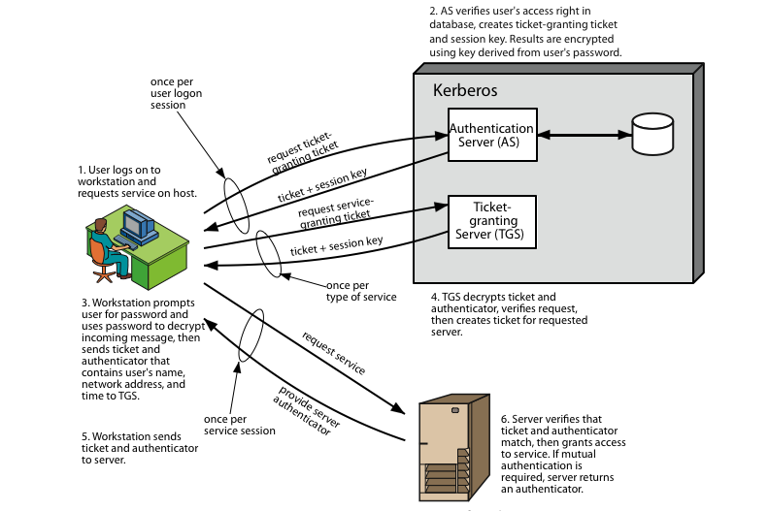
Actions in Kerberos v4

Slide 24
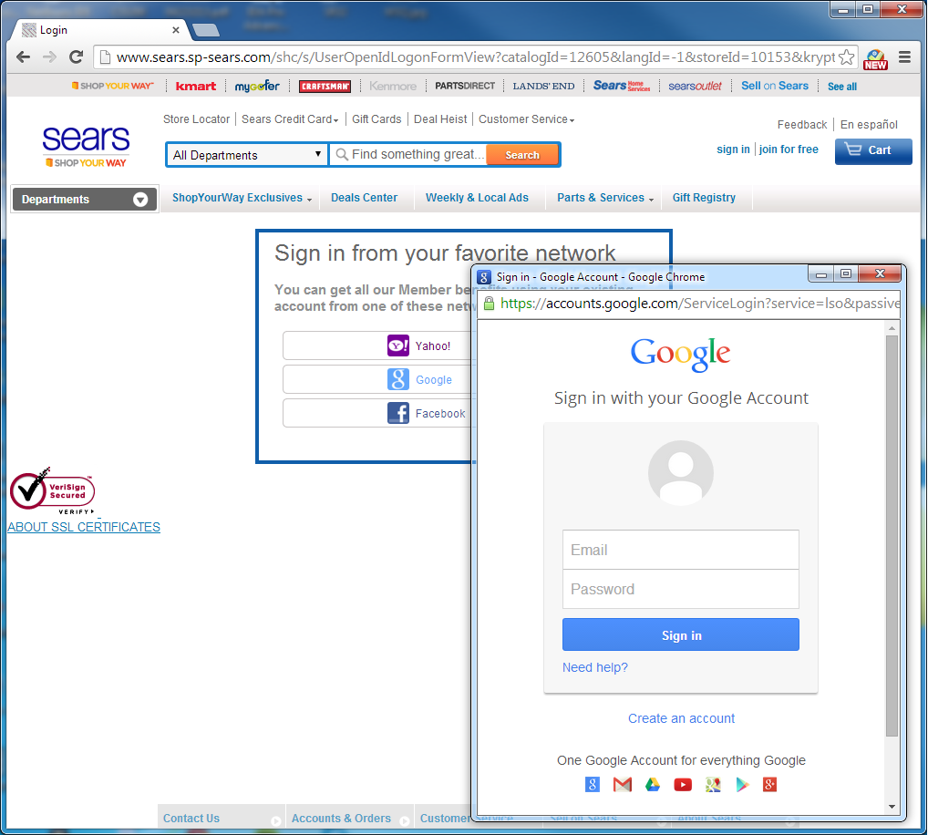
Web SSO Phishing
Traditional phishing can be very stealthy with the look and feel of phishing sites almost identical to the targeted legitimate sites.
Web Single Sign-On (SSO) phishing ^{[1]} can be more profitable, insidious, and harder to detect than traditional phishing.
[1] C. Yue. The Devil is Phishing: Rethinking Web Single Sign-On Systems Security. In Proc. of LEET, 2013
Notes:
Added by Chuan Yue at the Colorado School of Mines.

Slide 25
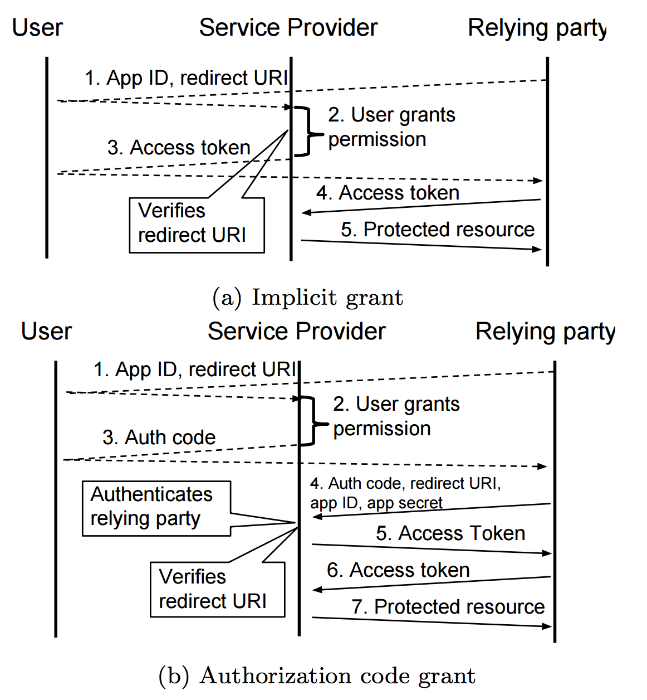
Two Grant Types of OAuth 2.0 (Figure 2 from the paper “OAuth Demystified for Mobile Application Developers”, CCS 2014)
RFC 6749 OAuth 2.0: https://tools.ietf.org/html/rfc6749
Please also check OpenID: http://openid.net/what-is-openid/
Notes:
Added by Chuan Yue at the Colorado School of Mines.

Slide 26
Summary
User authentication concepts
Multi-factor authentication
Password security
Biometric authentication
Kerberos
SSO

